Slide 1

On Becoming a Leader in Risk Management
Fundamentals of RM
RM System and Process
Leadership in RM
Incident Investigation
RM Tools & Challenges
RM in Industry
People & Org.
Applications & Perspectives
ENGG404 – Lecture
Case 5:
Exxon Valdez Loss Incident, 23-March-1989
1
Notes:
ENGG404 Lecture 00 - Day 1
2012 Fall
1
1

Slide 2
Learning Outcomes:
Explain the challenge of maintaining controls around acceptable risk.
Explore the basis for complacency in the following risk management system elements:
Incident Reporting, Investigation, Analysis, and Action
Management of Change
Recognize a situation about the degradation of (complacency in) incident investigation, and in management of change (ultimately in emergency preparedness), and apply the principles of risk management in a mini case study analysis.
Case 5: Exxon Valdez Loss Incident, Alaska
2
Notes:
2

Slide 3
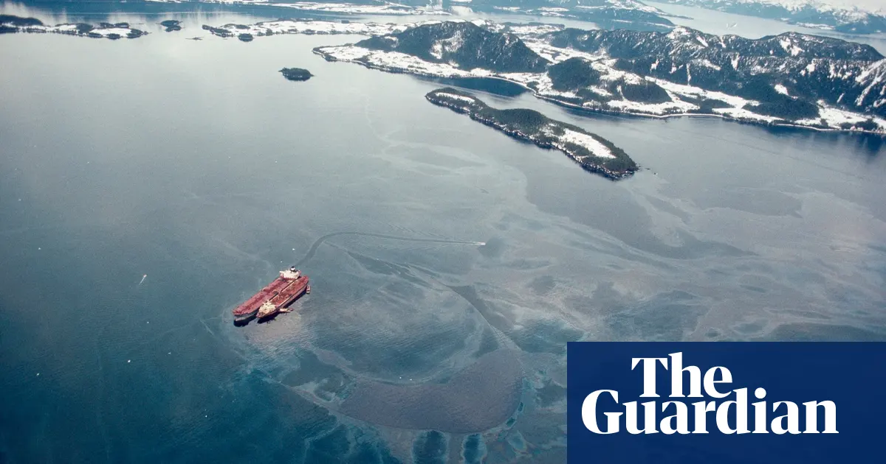
Introduction:
Exxon Valdez Loss Incident, 23-March-1989
Per the video, there was apparent complacency in these risk management system elements:
Incident Reporting, Investigation, Analysis, and Action
Management of Change
Case 5: Exxon Valdez Loss Incident, Alaska
3

Slide 4
Introduction:
Video: “The Big Spill” Exxon Valdez DVD ~1990 (on eClass)
Snippet A: 00:00 – 01:03 The Loss Incident
Snippet B: 02:04 – 02:54 Drilling history in Alaska, the Alyeska Consortium (the spill response co-operative), a spill was estimated at “once in 241 years”, and the environmentalists’ alarm about drilling in pristine Alaska. Low likelihood but extremely high consequence … certainly in hindsight.
Snippet C: 02:55 – 03:25 Shipping traffic: more than 300 billion gallons (1,200 billion litres) in 9,000 safe passages out-bound full plus 9,000 safe passages in-bound empty. Were there ever any near miss events? Other at-risk behaviours?
Snippet D: 03:26 – 06:02 The NTSB recounted events leading up to the grounding and the spill. The Captain steered a course to exit the out-bound shipping lane, transferred bridge command to the Third Mate, and did not stay on the bridge. This was a deviation from standard practices.
Snippet E: 06:03 – 06:42 Captain accused of alleged intoxication and negligence. If true – and it was proven to a degree – what allowed this to happen?
Snippet F: 06:43 – 07:27 Lee J. Raymond, Exxon President, made a statement. What motivated him to make this statement? How might you think the public responded?
Snippet G: 09:13-11:11 Alyeska Consortium was incapable of deploying the spill response plan. Why did this capability degrade over time?
Snippet H: 11:12-11:23 Impact on the Environment.
Case 5: Exxon Valdez Loss Incident, Alaska
4

Slide 5
Exploring Failures in Risk Management System Elements:
Please confer, and choose the video snippets that best demonstrate these two RMSE failures we are examining today:
Incident Reporting, Investigation, Analysis, and Action
Management of Change
Snippet A: 00:00 – 01:03 The Loss Incident
Snippet B: 02:04 – 02:54 Drilling history in Alaska, the Alyeska Consortium (the spill response co-operative), a spill was estimated at “once in 241 years”, and the environmentalists’ alarm about drilling in pristine Alaska. Low likelihood but extremely high consequence … certainly in hindsight.
Snippet C: 02:55 – 03:25 Shipping traffic: more than 300 billion gallons (1,200 billion litres) in 9,000 safe passages out-bound full plus 9,000 safe passages in-bound empty. Were there ever any near miss events? Other at-risk behaviours?
Snippet D: 03:26 – 06:02 The NTSB recounted events leading up to the grounding and the spill. The Captain steered a course to exit the out-bound shipping lane, transferred bridge command to the Third Mate, and did not stay on the bridge. his was a deviation from standard practices.
Snippet E: 06:03 – 06:42 Captain accused of alleged intoxication and negligence. If true – and it was proven to a degree – what allowed this to happen?
Snippet F: 06:43 – 07:27 Lee J. Raymond, Exxon President, made a statement. What motivated him to make this statement? How might you think the public responded?
Snippet G: 09:13-11:11 Alyeska Consortium was incapable of deploying the spill response plan. Why did this capability degrade over time?
Snippet H: 11:12-11:23 Impact on the Environment.
Case 5: Exxon Valdez Loss Incident, Alaska
5

Slide 6
Summary:
Two important RMEs for this case study incident:
Incident Reporting, Investigation, Analysis, and Action
Management of Change
Using the case study analysis, this loss incident demonstrates that it is vital to combat complacency in incident investigation and in management of change (ultimately in emergency preparedness) to prevent loss incidents.
These latter two elements demonstrate how a lack of compliance in one element can lead to (cause) a weakness in another element.
Case 5: Exxon Valdez Loss Incident, Alaska
6
Notes:
6

